Slide 1
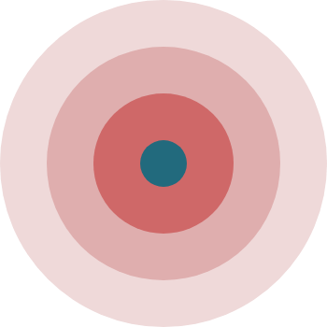
My Relief
Don’t let anything stop you!

Slide 2


Implement a Pain-Relieving Device Using Transcutaneous Electrical Nerve Stimulation “TENS”
Advisor: Dr. Bishoy E. Sedhom Eng. Aya Abdelmonem Eng. Shrouk Mohamed

Slide 3
Team Members:
Abdallah Abualkhair
Hanan Ahmed
Hussein Ramadan
Israa Elmorsy
Mariam Elhalawany
Mohamed Elaggouri
Reem Elsheikh
Youssef Abo Elyazed
Team Members
Microcontroller Interfacing
Hardware & Testing
PCB Design
Testing
PCB Design
Hardware & Testing
Circuit Analysis
PCB Design
Hardware & Testing
Mobile Application
Microcontroller Interfacing
Testing
Mobile Application
3D Design
Microcontroller Interfacing
Circuit Analysis
Circuit Analysis
Designer
Designer

Slide 4
Agenda:
Project definition
PCB Design & Circuit
Mobile Application
Results & Future Work
Methodology
3D Design
Microcontroller

Slide 5
Project Definition

Slide 6
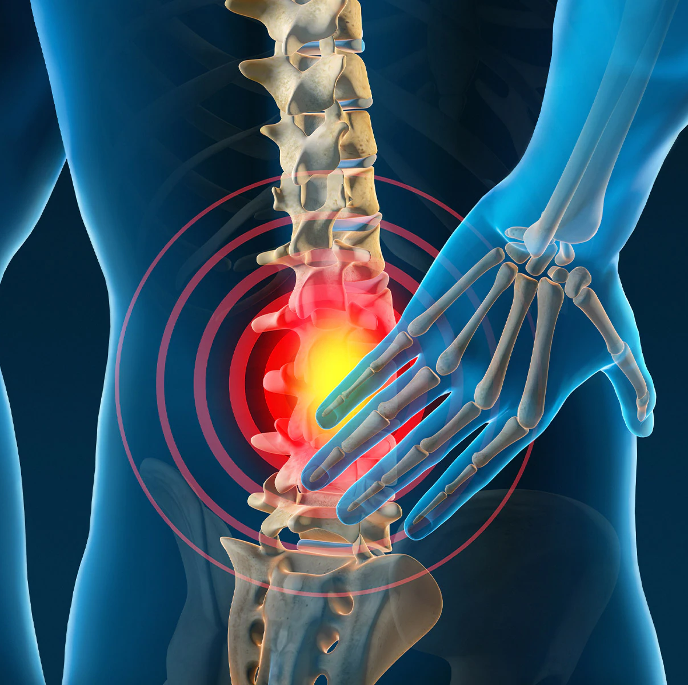
Problem statement:
Pain is the human’s oldest trouble that has been affecting the human quality of life.
Pain is more than just a feeling of discomfort. It can affect the way you feel overall. It may also lead to mental health conditions, like depression and anxiety.

Slide 7
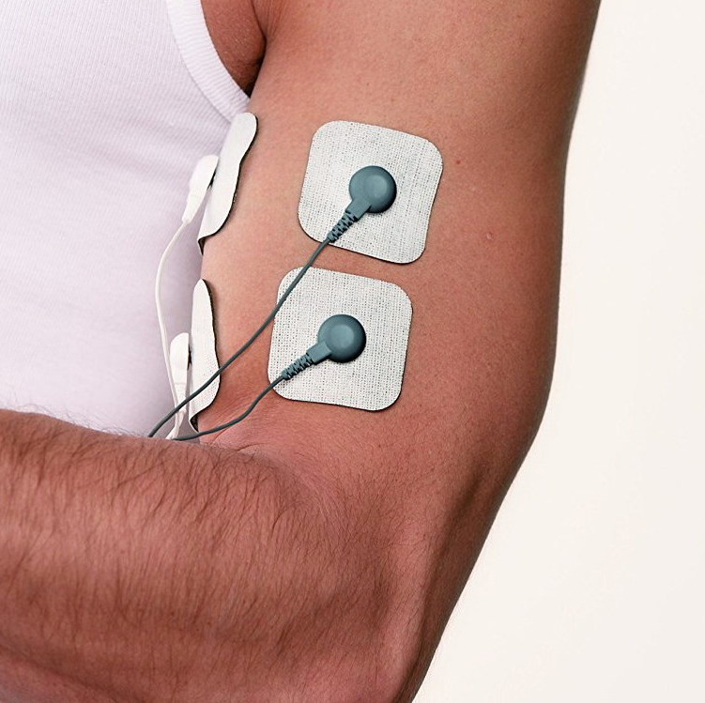
TENS
Transcutaneous electrical nerve stimulation (TENS) is a non-invasive peripheral stimulation technique used to relieve pain.
During TENS pulsed electrical currents are delivered across the intact surface of the skin to activate underlying nerves.

Slide 8
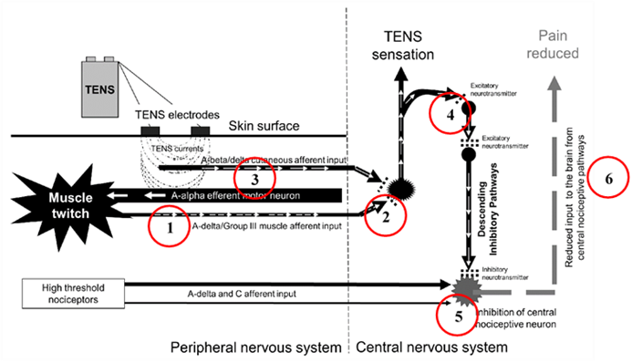
Activity in peripheral nociceptive afferents
releases excitatory neurotransmitters.
causing activity in second order nociceptive transmission cells in the central nervous system.
which leads to pain. Activation of large diameter non-noxious afferents by TENS

Slide 9
Activity in peripheral nociceptive afferents:
causes the release of inhibitory neurotransmitters which reduce activity in second order nociceptive transmission cells.
The reduction in nociceptive input to the brain results in pain relief.
TENS induced activity in non-noxious transmitting pathways in the central nervous system results in a sensation of electrical paraesthesia.

Slide 10
Characteristics of different TENS techniques:
Conventional TENS
Acupuncture-like TENS
Intense TENS

Slide 11
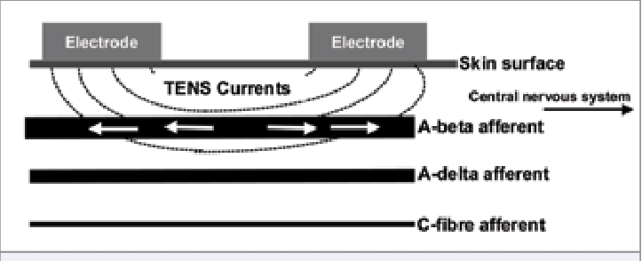
Characteristics of different TENS techniques: 1. Conventional TENS
Physiological Intention
To selectively activate large diameter non-noxious afferents to elicitsegmental analgesia.
Clinical Technique
Low-intensity / high-frequency TENS at site of pain to produce “strong but comfortable TENS paraesthesia”. Administer whenever in pain.

Slide 12
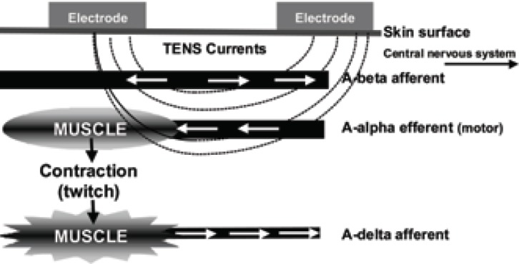
Characteristics of different TENS techniques: 2. Acupuncture-like TENS
Physiological Intention
To produce muscle twitches to activate small diameter motor afferents to elicit extrasegmental analgesia
Clinical Technique
High-intensity / low-frequency TENS over muscles, acupuncture points or trigger points to produce “strong but comfortable muscle contractions”. Administer for 15-30 minutes at a time.

Slide 13
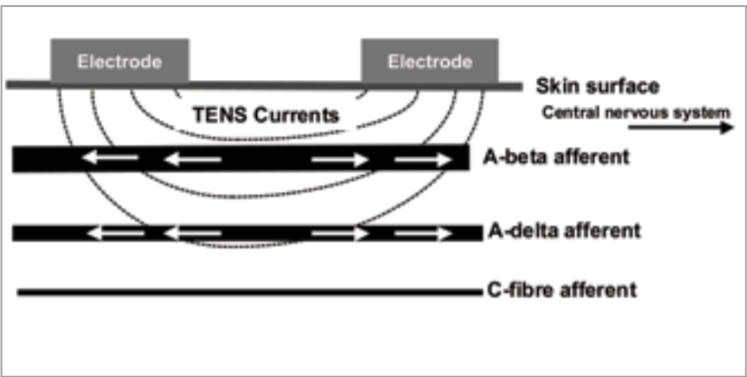
Characteristics of different TENS techniques: 3. Intense TENS
Physiological Intention
To activate small diameter noxious afferents to elicit peripheral nerve blockade and extrasegmental analgesia.
Clinical Technique
High-intensity / high-frequency TENS over nerves arising from painful site to produce “maximum tolerable (painful) TENS paraesthesia”. Administer for a few minutes at a time.

Slide 14
Common conditions for which TENS has been used:
Osteoarthritis
Fibromyalgia
Tendinitis
Bursitis
Diabetic neuropathy
Period Pain

Slide 15
When to avoid TENS:
Pregnant women: Pregnant women should avoid using TENS in the abdominal and pelvic regions.
People with epilepsy: Applying electrodes to the head or neck of people with epilepsy may induce seizures.
People with heart problems.
People with a pacemaker or another type of electrical or metal implant.

Slide 16

Goals and objectives:
The goal of this project is to present an easily operated TENS device using a microcontroller to supply electrical impulses. also, the device is controlled by mobile application via Bluetooth to let user choose which program to applied, control the frequency, pulse width value in limit range and set a timer for his therapy session.

Slide 17

Cost:
1500 EGP

Slide 18

Cost:
After studying many products and looking at their prices, we found that most of the prices start from 31 dollars and above, excluding taxes, which is equivalent to 500 Egyptian pounds. These devices are of poor quality as they support some simple programs with a short lifespan.
The price of the device increases with the increase in its quality, as there are devices that exceed 10,000 Egyptian pounds.

Slide 19
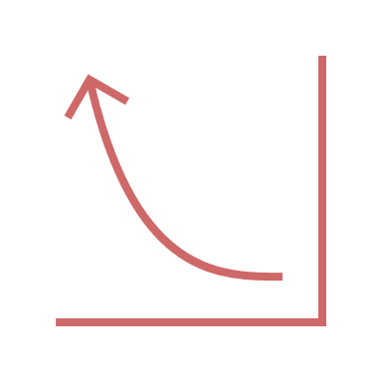
Required:
Mobile application programming.
PCB Design

Slide 20
Methodology

Slide 21
Mobile Application
PCB Design
Enclosure 3D Design
Microcontroller Interfacing
Hardware and Testing

Slide 22
Microcontroller

Slide 23
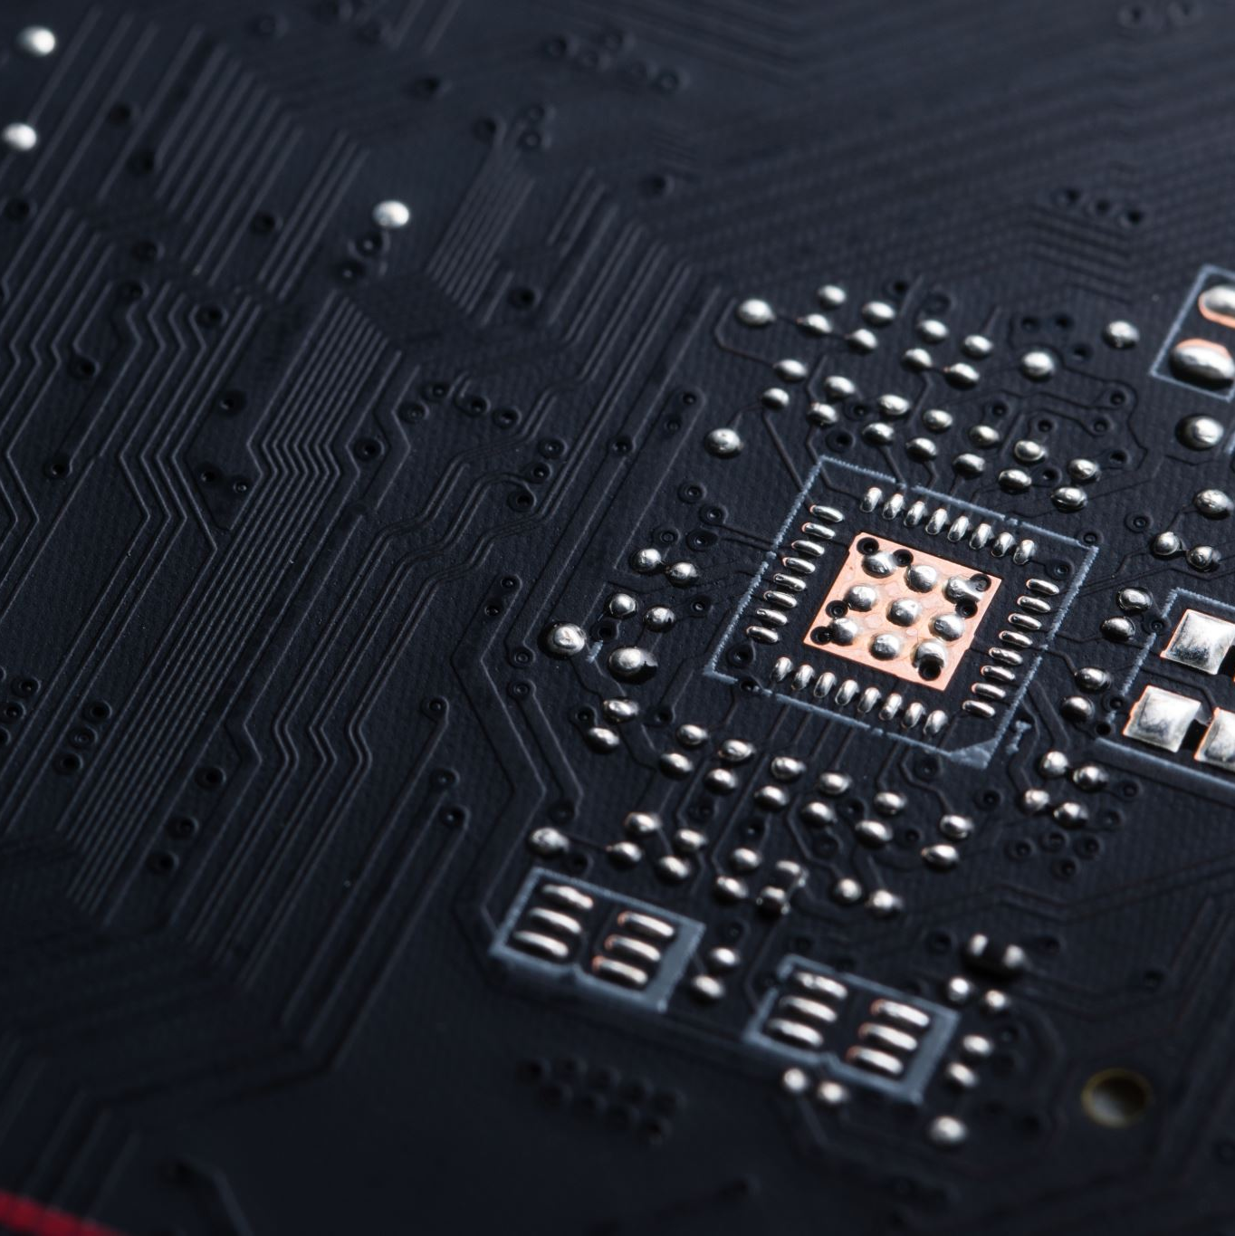
Main functions:
Setting TENS values
Communication with Bluetooth.
Battery charge indicator

Slide 24
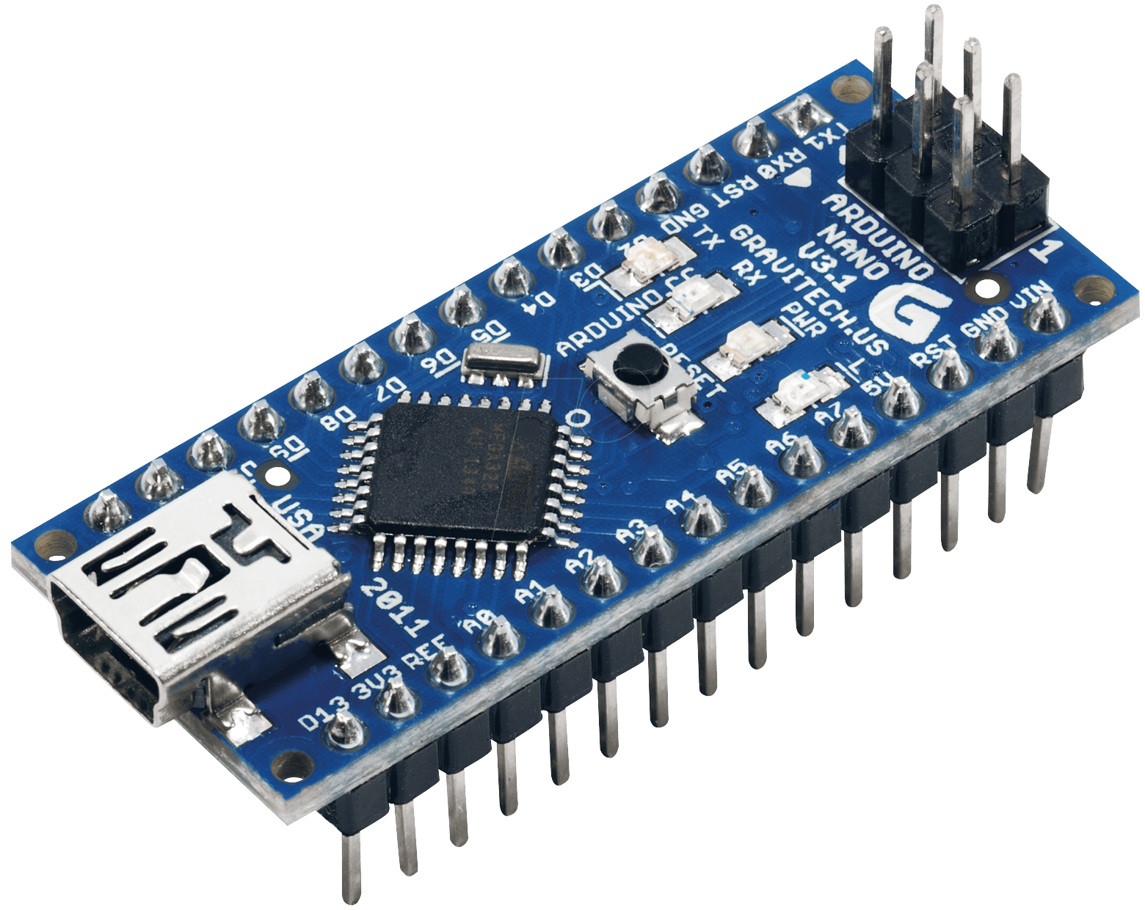
Main functions:
Arduino Nano is a microcontroller board designed by Arduino.cc. The microcontroller used in the Arduino Nano is Atmega328, It has a wide range of applications and is a major microcontroller board because of its small size and flexibility.

Slide 25
Features:
Microcontroller type | ATmega328
Architecture | AVR
Operating voltage | 5 V
Flash memory | 32 KB of which 2 KB used by bootloader
SRAM | 2 KB
Clock speed | 16 MHz
Numbers of IN Analog pins | 8
EEPROM | 1 KB
DC current per I/O pins | 40 mA
Input voltage | 7 – 12 V
Digital I/O pins | 22
PWM output | 6
Power consumption | 19 mA
Size | 18 * 45 mm
Weight | 7 g

Slide 26
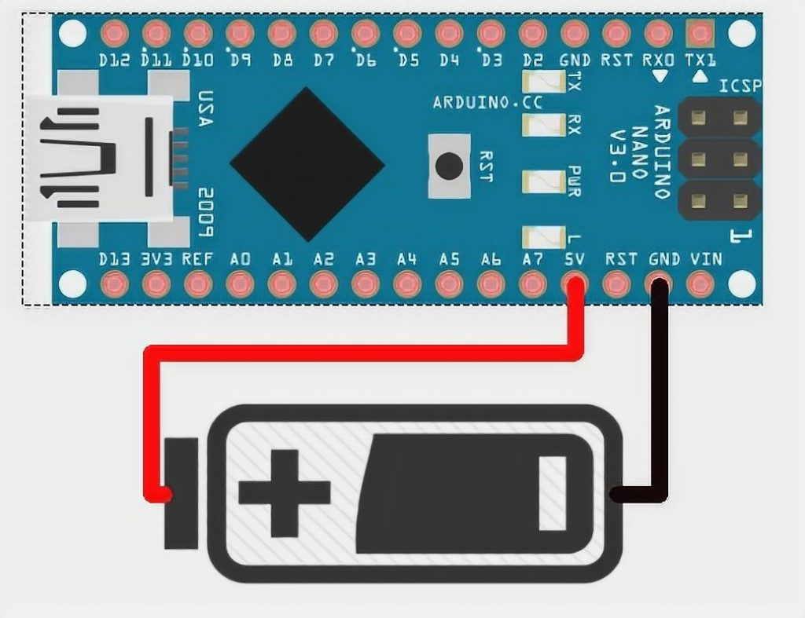
Powering:
The Arduino Nano can be powered via the Mini-B USB connection, 6-20V unregulated external power supply (Vin pin), or 5V regulated external power supply (5V pin).
In our project we depend on last method when we be sure the maximum value it will be 4.2 volt.

Slide 27
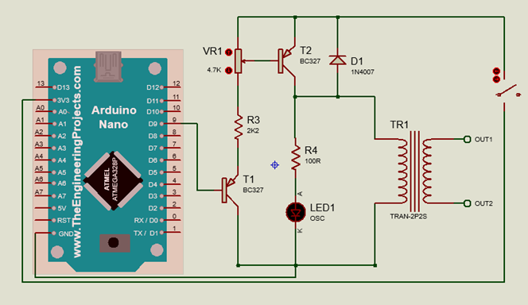
Setting TENS value:
We depend on the Timer1 of Atmega328 microcontroller to produce the resided output we will need for operating tens, which is assigned to pin “D9”.
Timer1 library is a collection of routines for configuring the 16-bit hardware timer called Timer1 on the ATmega168/328.

Slide 28
Setting TENS value:
PWM (pin, duty, period)
this will be generating a PWM waveform on the pin9.

Slide 29
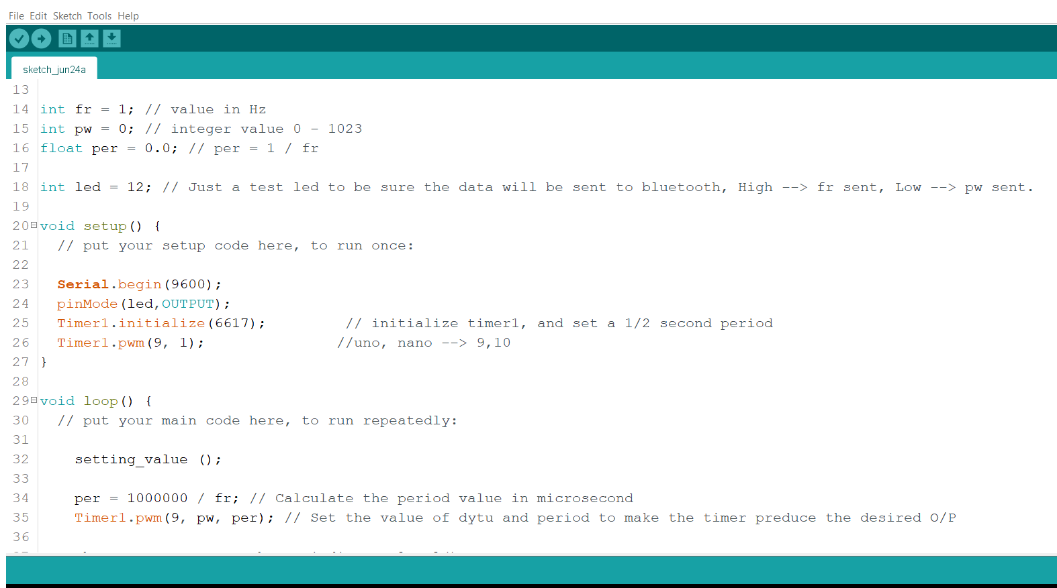
Setting TENS value:

Slide 30
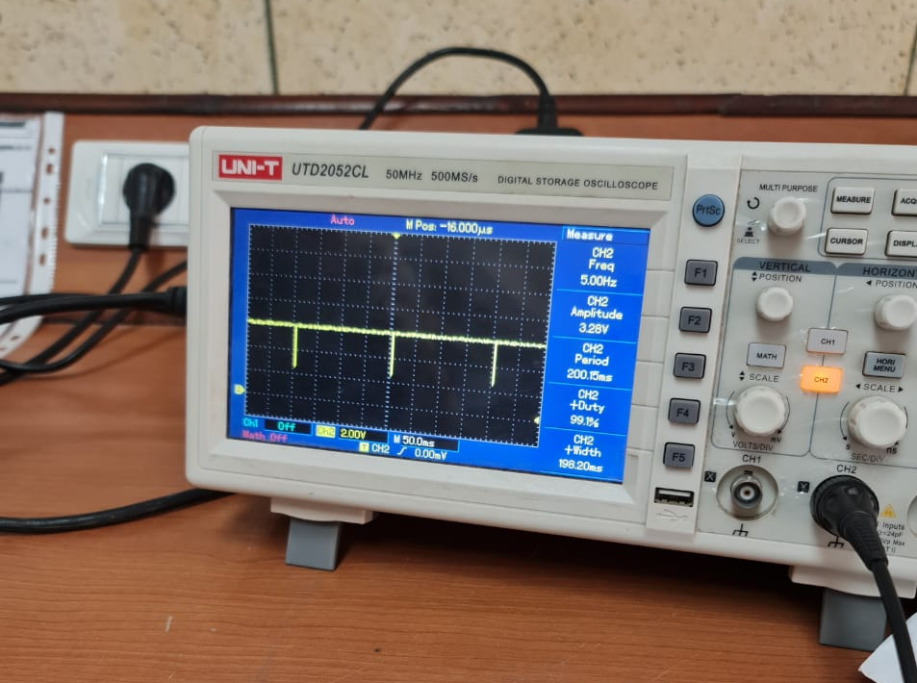

Slide 31
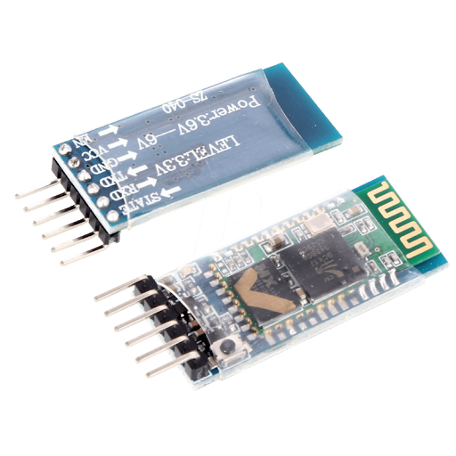
Communication with HC-05:
Hc-05 Bluetooth module is a special module which can add two-way (full-duplex) wireless functionality to projects.

Slide 32
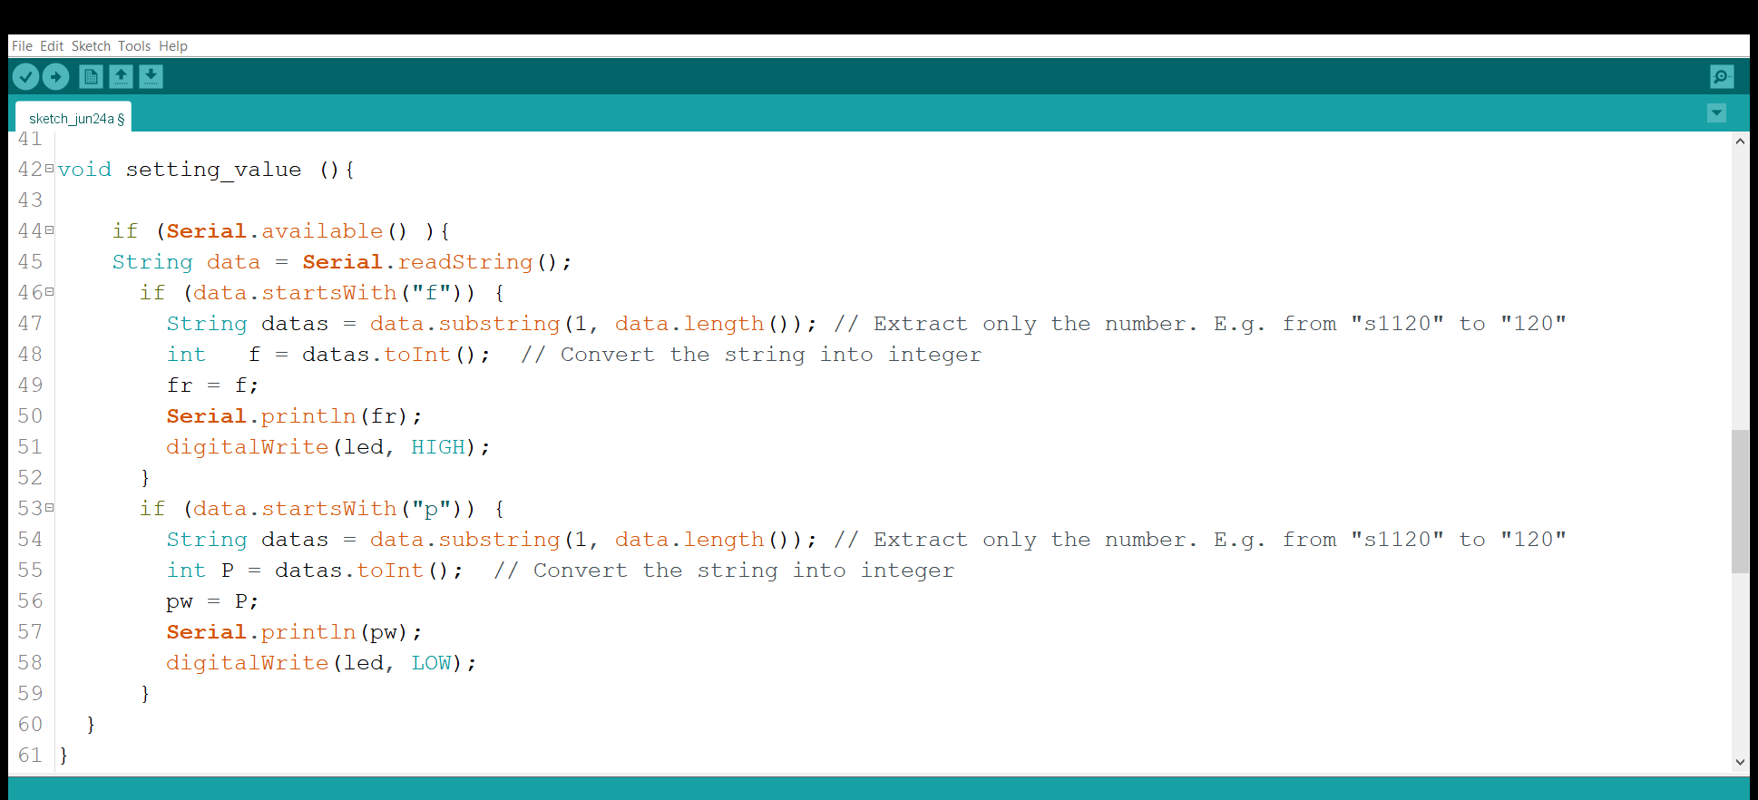
Communication with HC-05:

Slide 33
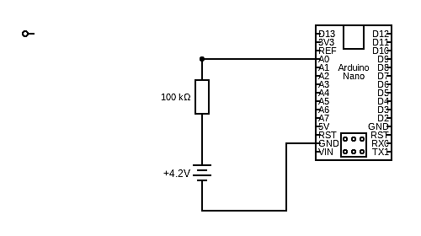
Battery charge indicator:

Slide 34
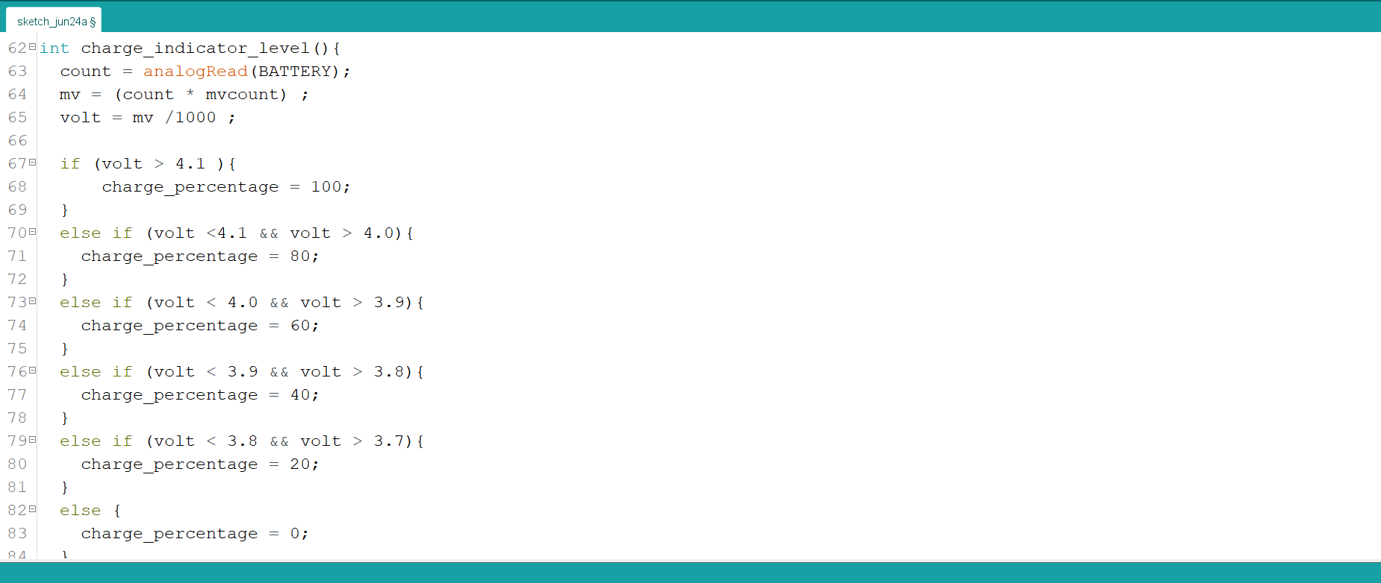
Battery charge indicator:

Slide 35
PCB & Circuit

Slide 36
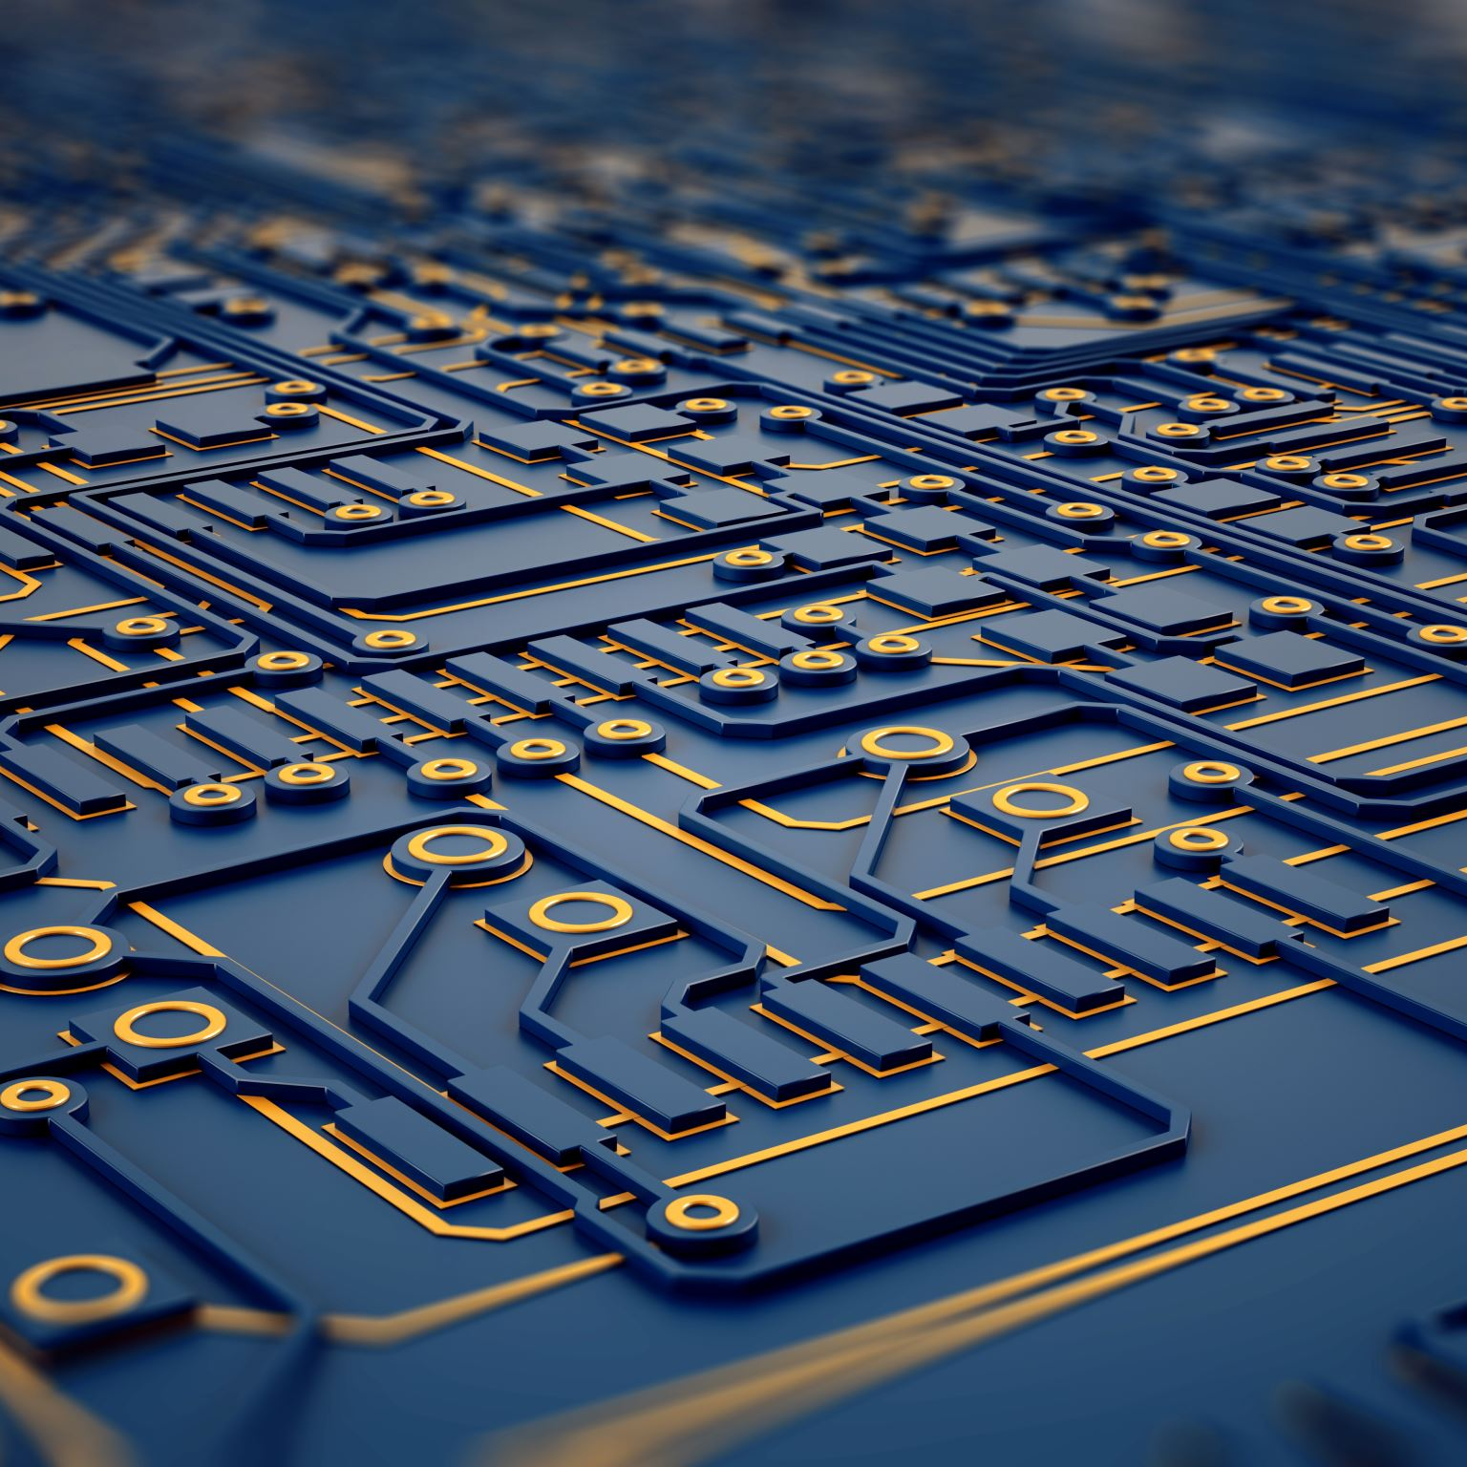
Why PCB design?
Compact Size and Saving of Wire
Ease of Repair and Diagnostic
Saving of Time
Immune to Movement
Low Electronic Noise and Low Cost

Slide 37
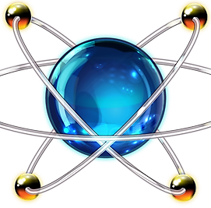
Software designing selected:
Using proteus since it has some features which help us in design:
Schematic drawing
Simulation
Designing PCB
3D visualization

Slide 38
Electrical Circuit:
Arduino Nano (ATmega 328)
Transistors (BC327)
Potentiometer
Transformer
Diode
Charge Module
Lithium Battery
Switch
Indicator Led

Slide 39
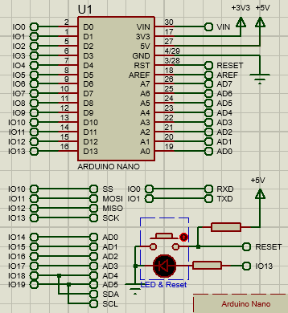
Electrical Circuit: 1. Arduino Nano:
The main component that will output a desired signal through timer 1 on pin 9.

Slide 40
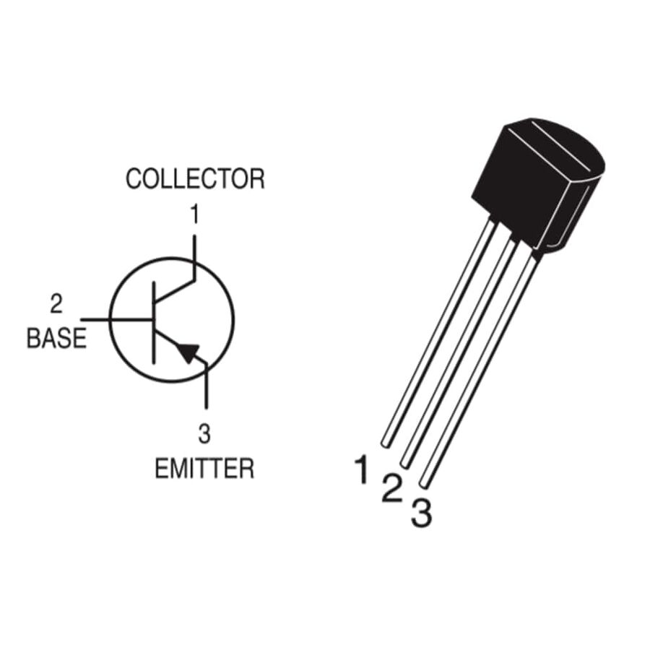
Electrical Circuit: 2. Transistors:
T1(PNP-BC327):
T2(PNP-BC327):
Acts as a safety component for arduino nano
Acts as a switch ON/OFF
T1 will be ON when low voltage is applied on the base terminal
T1 will be ON when low voltage is applied on the base terminal

Slide 41
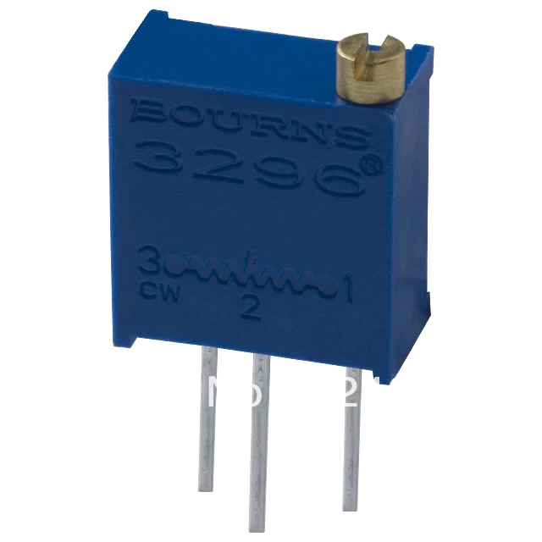
Electrical Circuit: 3. Potentiometer:
Which lies between T1 & T2 act as voltage divider and determine the output intensify of T2.

Slide 42
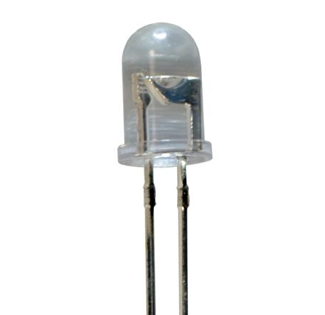
Electrical Circuit: 4. LED:
Acts as an indicator of the transistor's output and blinks to indicate the frequency and pulse width produced by timer 1.

Slide 43
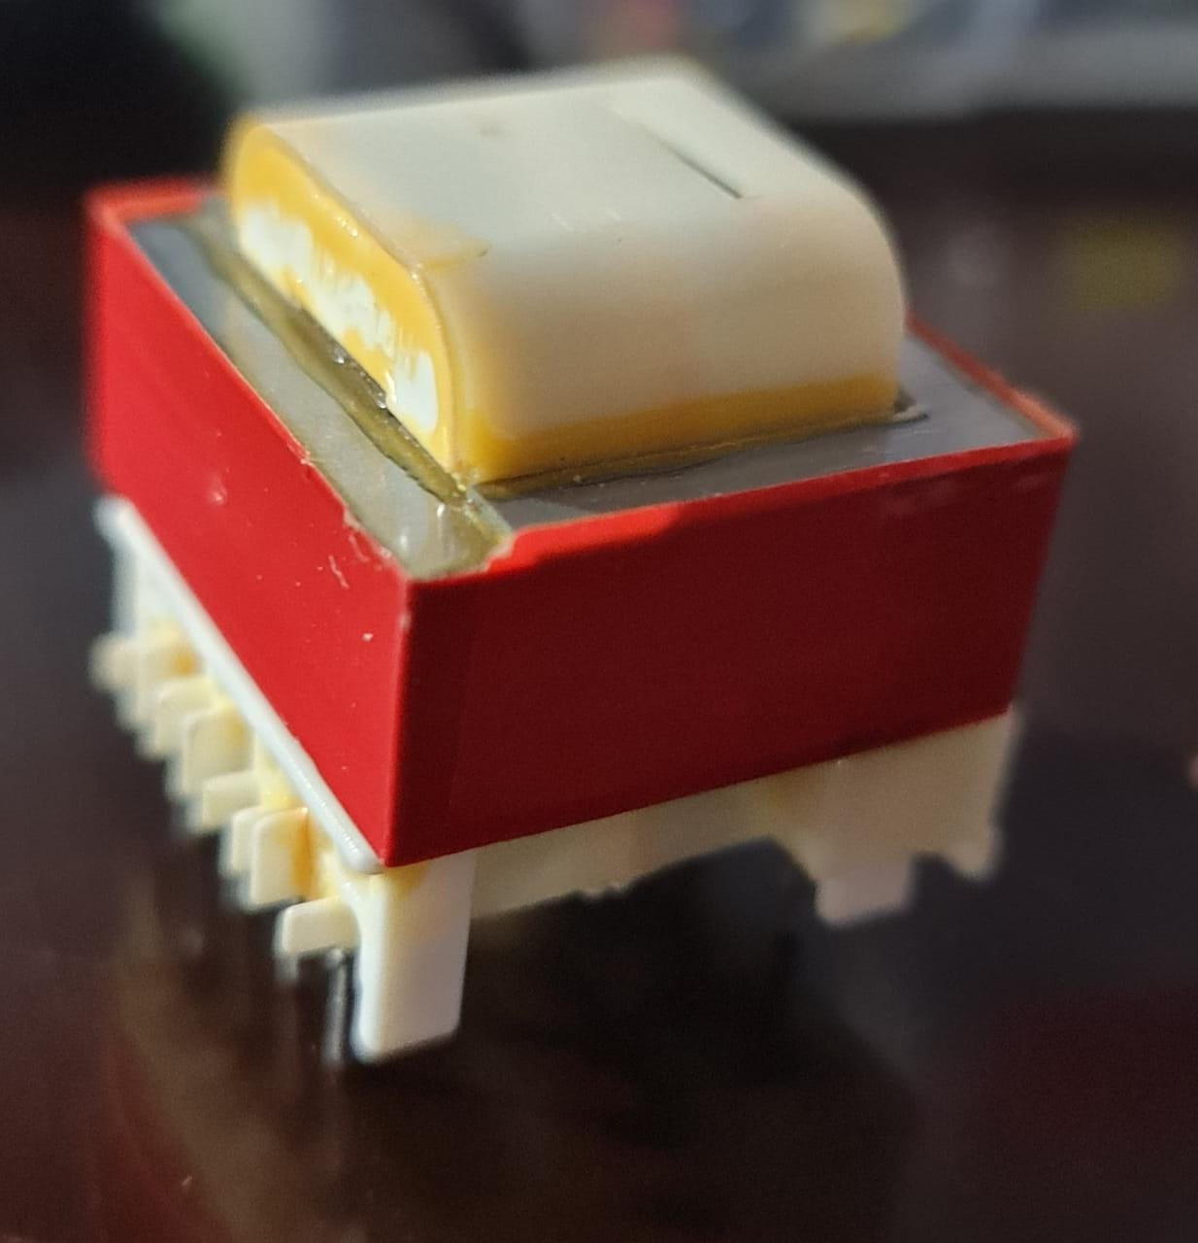
Electrical Circuit: 5. Transformer:
Is the final step in the circuit, it function is to step up the voltage from 3v supplied from battery to 25-35v with a load.

Slide 44
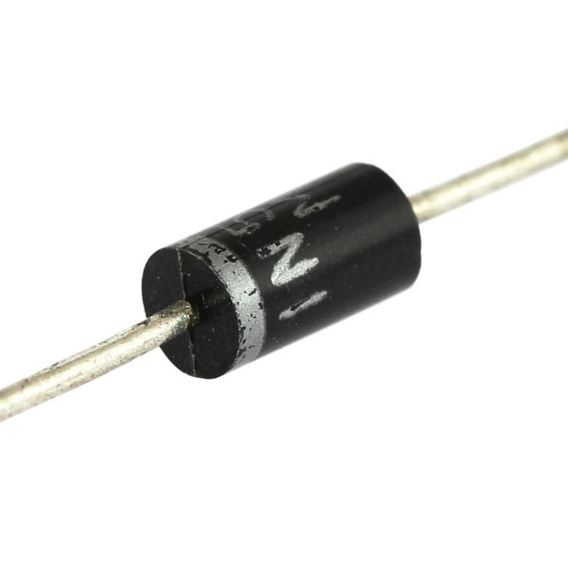
Electrical Circuit: 6. Diode:
When using an inductive load such as transformer, it is advisable to connects a diode directly across the load terminal to absorb any back emf voltage.

Slide 45
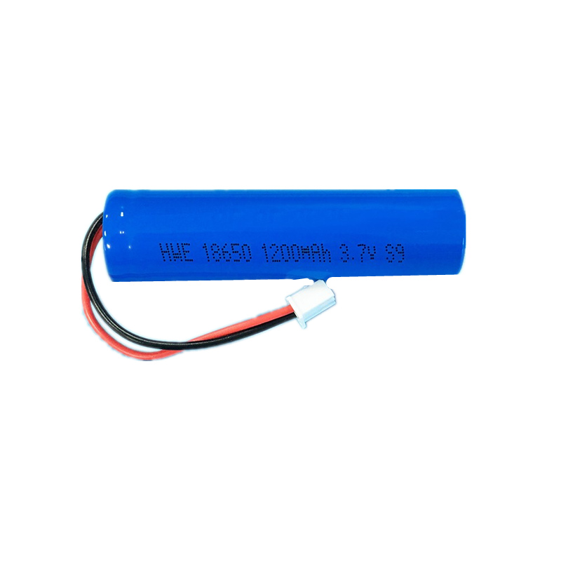
Electrical Circuit: 7. Battery:
Circuit is powered by Li-ion battery 3.7V

Slide 46
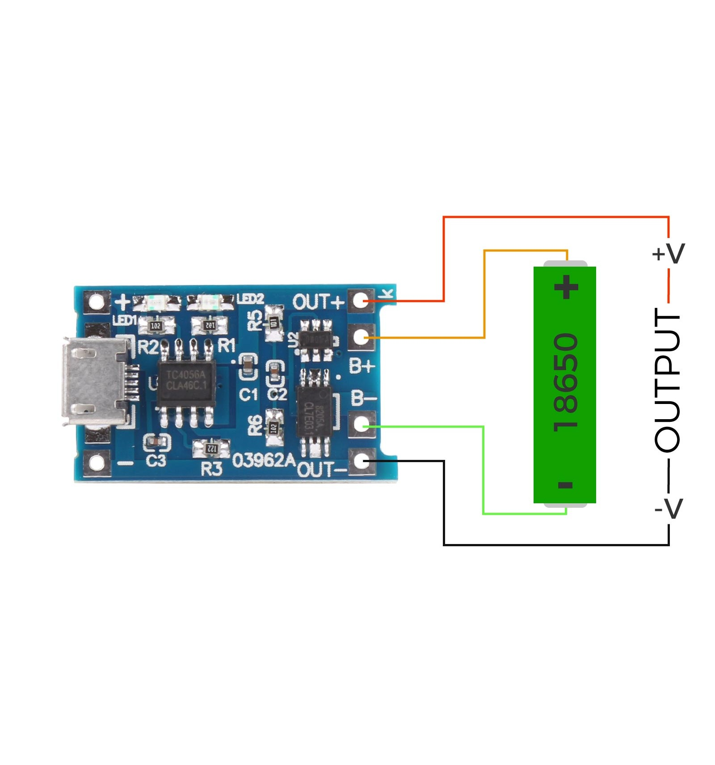
Electrical Circuit: 8. Charge Module:
That used for charging single-cell lithium battery through connecting up to 5V DC supply or a Mini-USB port.

Slide 47
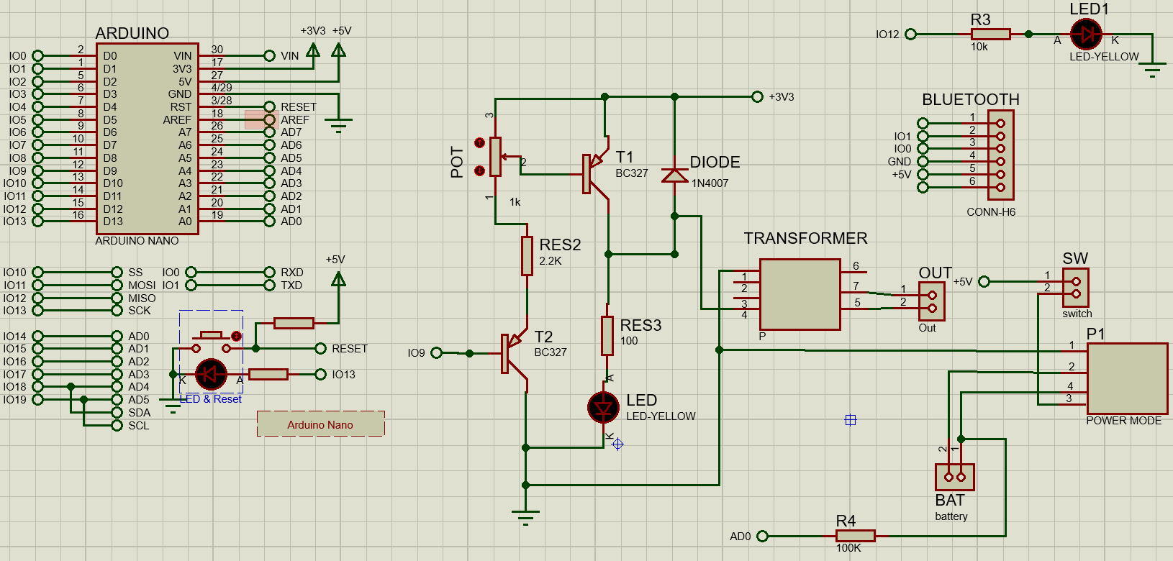
Final Schematic capture

Slide 48
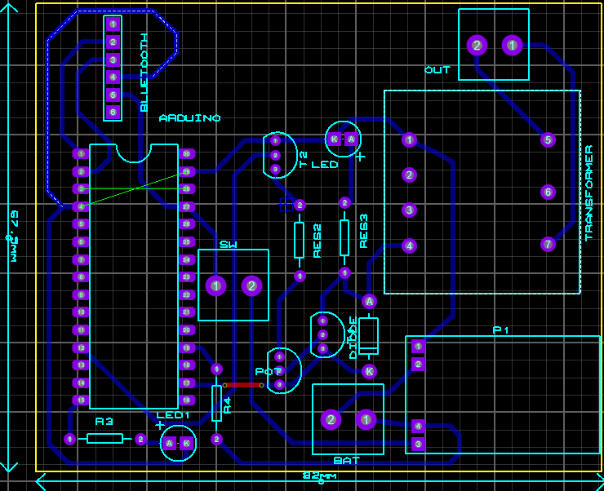
PCB

Slide 49
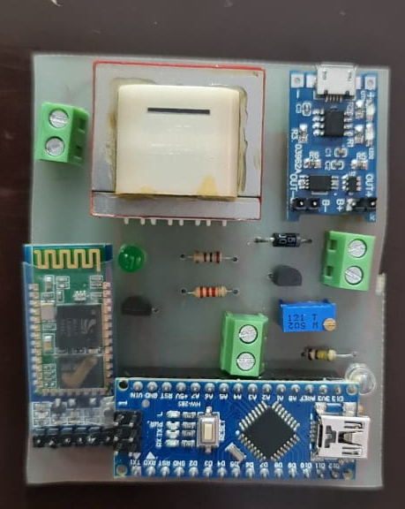
Final Circuit

Slide 50
Mobile Application

Slide 51

Flutter:
Flutter is Google's UI toolkit for building beautiful, natively compiled applications for mobile, web, and desktop from a single codebase. Flutter works with existing code, is used by developers and organizations around the world, and is free and open source.

Slide 52
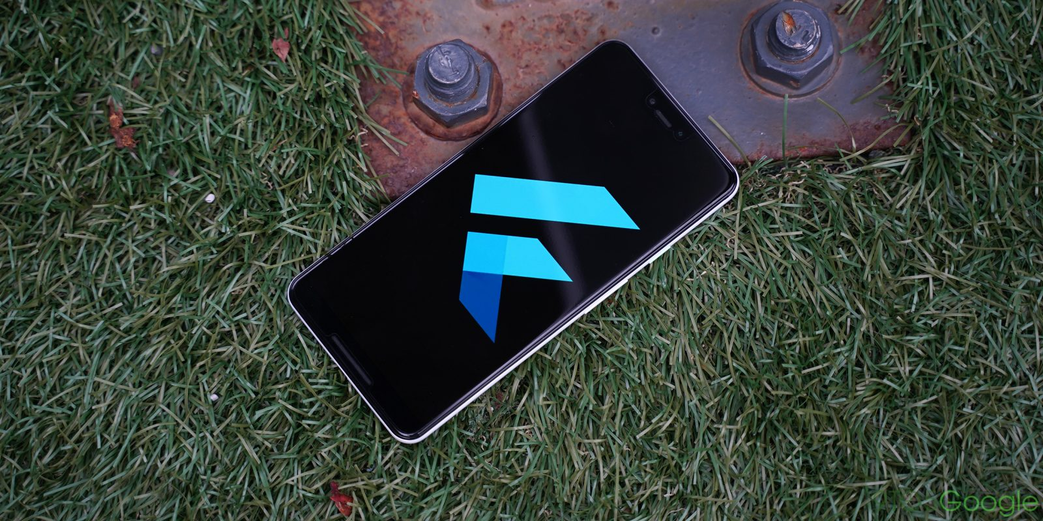
Why flutter?
Fast development
Hot reload
Flutter offers a lot of widgets
Expressive and fixable UI
Native performance
Pixel perfect
Uses dart programming language
Cross platform that can be used for android and iOS

Slide 53
My Relief app:
Homepage
Manual Mode
Body Parts
User
Help video 1
Help video 2
Setting
Precautions
About us

Slide 54
Home page:
Body Parts
Consists of 11 programs for different parts of human body with pre - programmed parameters , and slider within the safe range for each part.
Manual Mode
Used under doctor supervision , to provide customized programs according to doctor recommendation.

Slide 55
User page:
Help video 1
how the TENS device used with mobile application .
Help video 2
How to run My Relief

Slide 56
Setting page:
Precautions
Precautions that must be followed while using the device, such as places where the device is prohibited, such as the face and neck, as well as people prohibited from using the device such as pregnant women, heart patients and epilepsy
About us
Brief about team and project

Slide 57
Packages and plugins used in flutter app:
Import 'package:flutter_bluetooth_serial/flutter_bluetooth_serial.dart’;
The first goal of this project, started by @edufolly was making an interface for Serial Port Protocol (HC-05 Adapter). Now the plugin features:
Discovering devices (and requesting discoverability),
Listing bonded devices and pairing new ones,
Connecting to multiple devices at the same time,
Sending and receiving data multiple connection
There could be max up to 7 Bluetooth connection
For now, there is only Android support.
Usage :
flutter_bluetooth_serial: ^0.3.0

Slide 58
Packages and plugins used in flutter app:
import 'package:intl/intl.dart’;
Provides internationalization and localization facilities, including message translation, plurals and genders, date/number formatting and parsing, and bidirectional text.
Usage :
dependencies: intl: ^0.17.0

Slide 59
Packages and plugins used in flutter app:
import 'package:flutter_app/helper.dart';
A library module containing code that can be shared easily across multiple Flutter or Dart projects.
Usage :
dependencies: helper: ^0.0.14

Slide 60
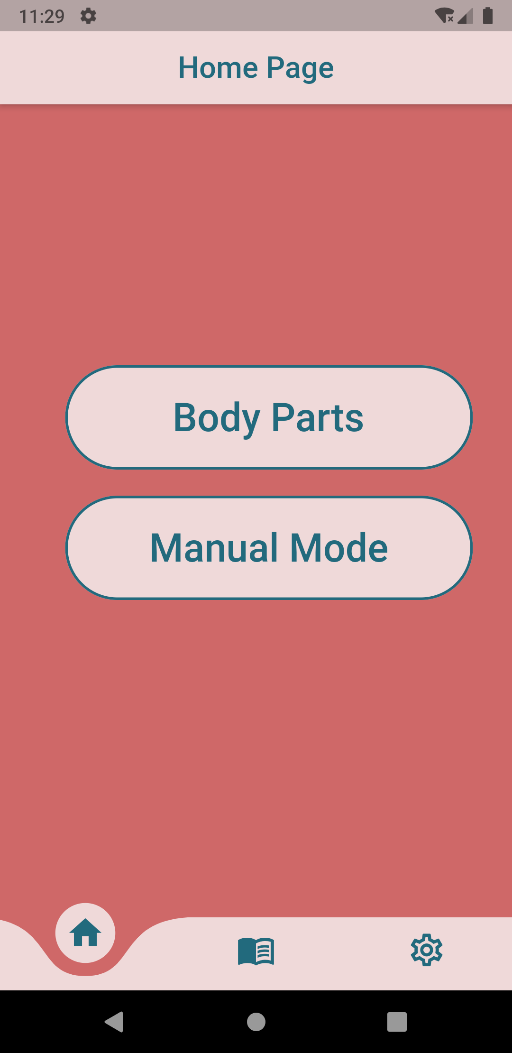
Parts Of The Page In Flutter:
App Bar
Body
Navigation Bar

Slide 61
Navigation Bar:
Bottom Navigation Bar allows you to select one item at a time and quickly navigate to a given page.

Slide 62
int r= 0;
List<Widget> _widget Options = <Widget>[
Home Page(),
User(),
Setting(),
];
void _on Item Tap(int index) {
set State(() {
r = index;});}
items: [Icon(Icons.home,size:30,
color: Color(0xff226a7d),),
Icon(Icons.menu_book,size:30,
color: Color(0xff226a7d),),
Icon(Icons.settings_outlined,size:30,
color: Color(0xff226a7d),),],
on Tap: _on ItemTap,),);}
bottom Navigation Bar: Curved Navigation Bar(
color: Color(0xffefd9d9),
background Color: Color(0xffcf6868) ,
height:56,
animation Duration: Duration(milliseconds: 400,),

Slide 63
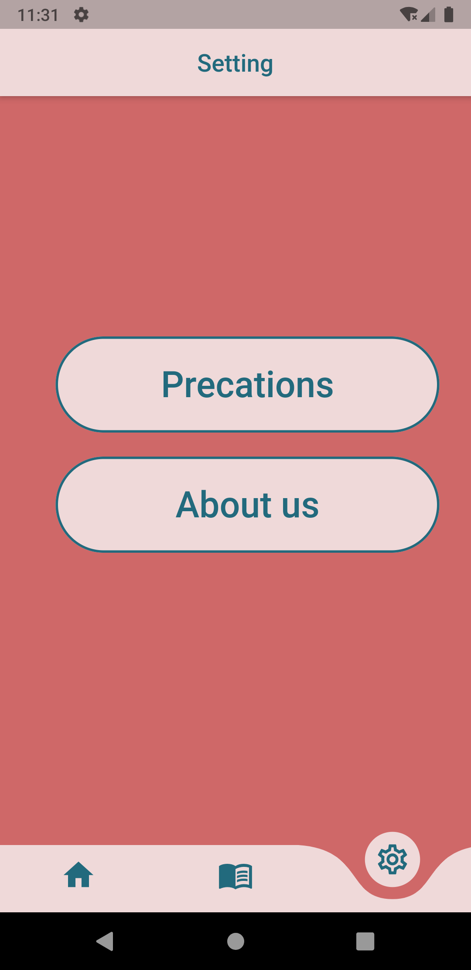
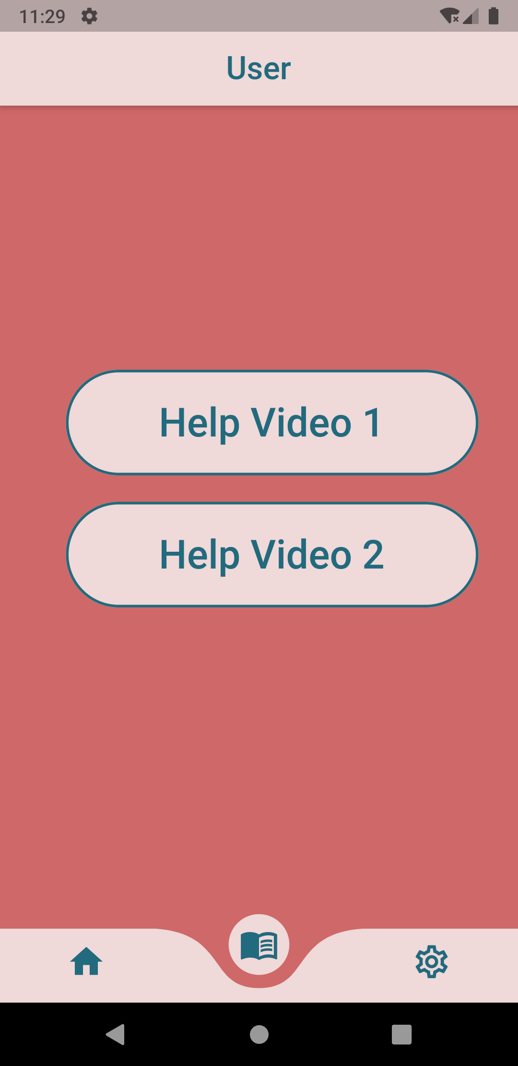
The body part on the main page of the application:

Slide 64
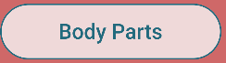
Container:
Container class provides a convenient way to create a widget with specific properties: width, height, background color, padding, borders, and more.

Slide 65
Container(
margin: Edge Insets. only(left: 50, right: 30),
width: 320,
height: 80,
decoration: Box Decoration(
border Radius: Border Radius. circular(80.0),
color: const Color(0xffefd9d9),
border: Border. all(
width: 2, color: const Color(0xff226a7d)),),
alignment: Alignment. center,
child : Material Button(
on Pressed: (){
Navigator . push (
context,
Material Page Route(
builder:(context) => Body Parts(),),);},
child: Text("Body Parts",
style: Text Style(
font Family: 'Script MT',
font Size: 30,
color: const Color(0xff226a7d),
font Weight: FontWeight.w500,),),),),

Slide 66
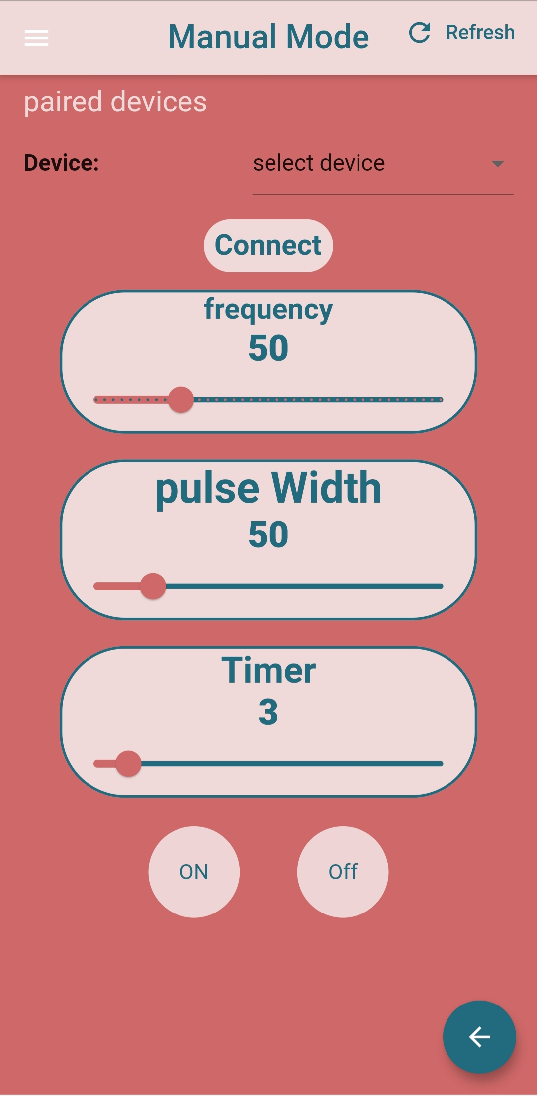
Slider:
Slider is a material design widget used for selecting a range of values.

Slide 67
double frequency = 50;
double pulse = 50;
Slider( value: frequency,
max: 200,
min: 0,
divisions: 40,
active Color: Color(0xffcf6868),
inactive Color: Color(0xff226a7d),
on Change End: (double b) {
set State(() {
frequency = b;
print(frequency);
print('===========================');
_send Text Message To Bluetooth('f' + b.to String());});},
on Changed: (value) { set State(() {
frequency = value;});}),

Slide 68
Bluetooth
Switch(
active Color: Colors. blue[900],
value: _Bluetooth State.is Enabled,
on Changed: (bool value) {
future() async {
if (value) {
await Flutter Bluetooth Serial.in stance. request Enable();}
else {
await Flutter Bluetooth Serial.in stance. Request Disable();}
await get Paired Devices();
_is Button Unavailable = false;
if (_connected) {
_disconnect();}}
future().then((_) {
set State(() {});});},)

Slide 69
User:
Open ur1 ()
{
String url1 = "https://www.youtube.com/watch?v=OwEpeJfcMf4";
launch(url1);
}
Open ur2 ()
{
String url1 = "https://www.youtube.com/watch?v=dT2nVlOdNHk";
launch(url1);
}

Slide 70
3D Design

Slide 71
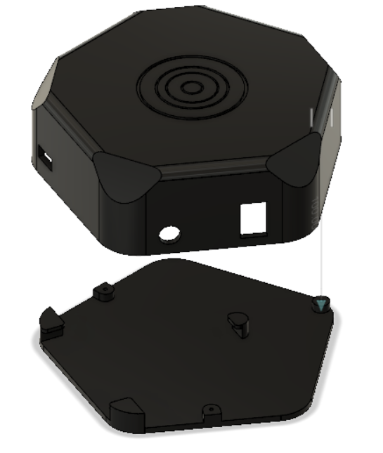
Final Design

Slide 72
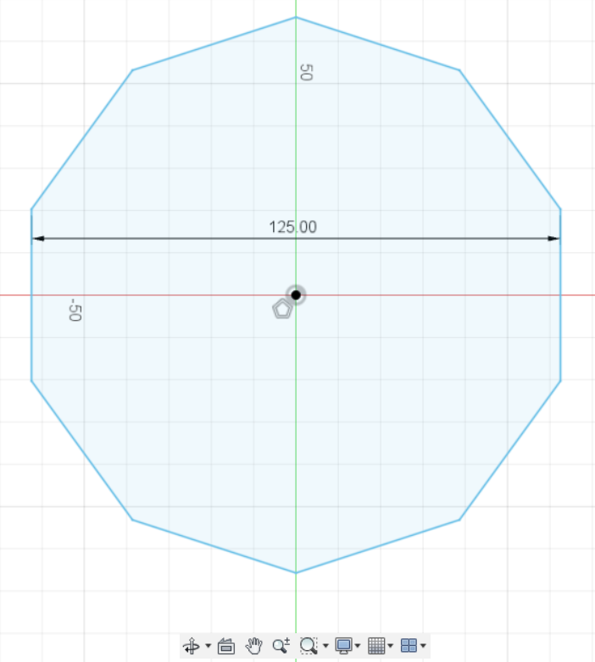
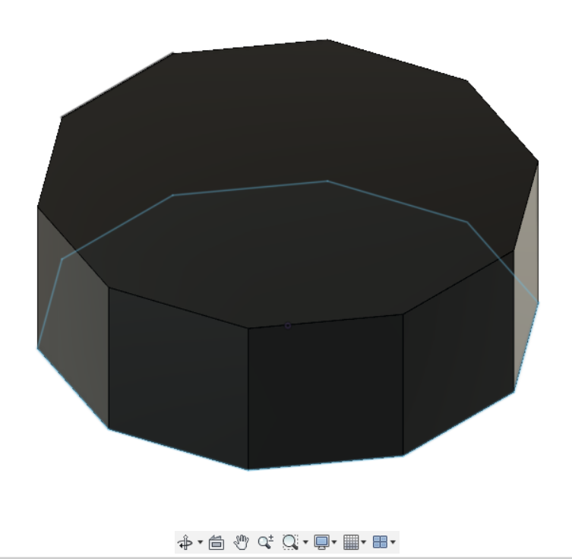
Creating the sketch of the case
Extruding the shape drawn on the sketch

Slide 73
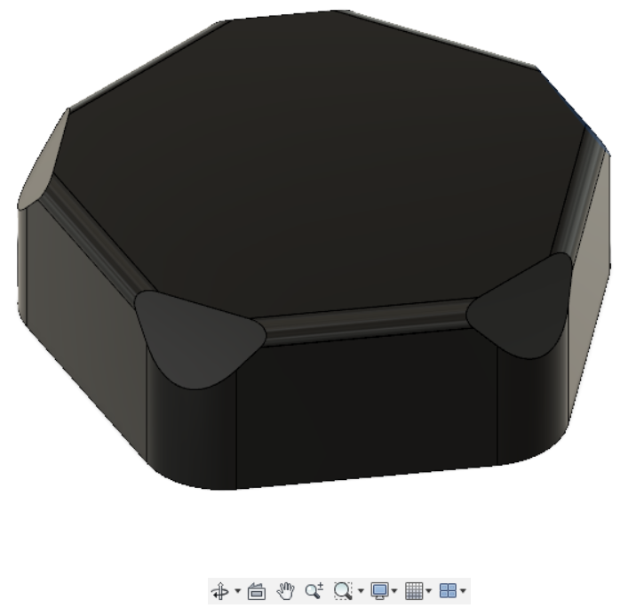
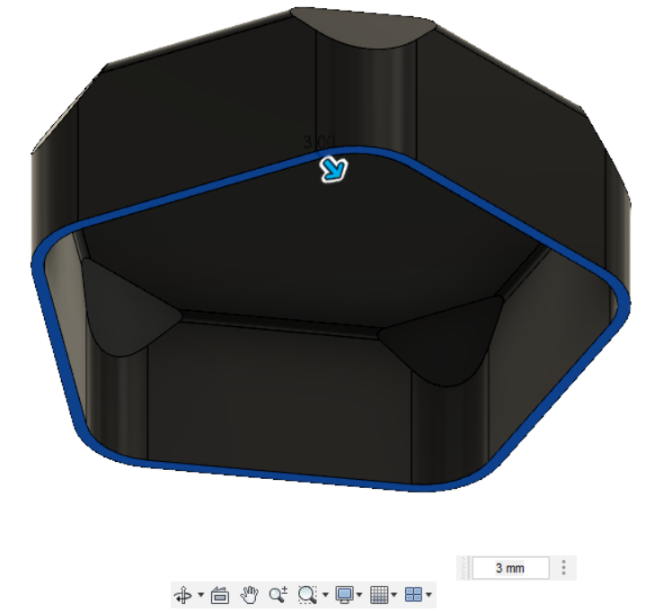
Applying fillet feature to the edges
Shell feature applied on the solid part

Slide 74
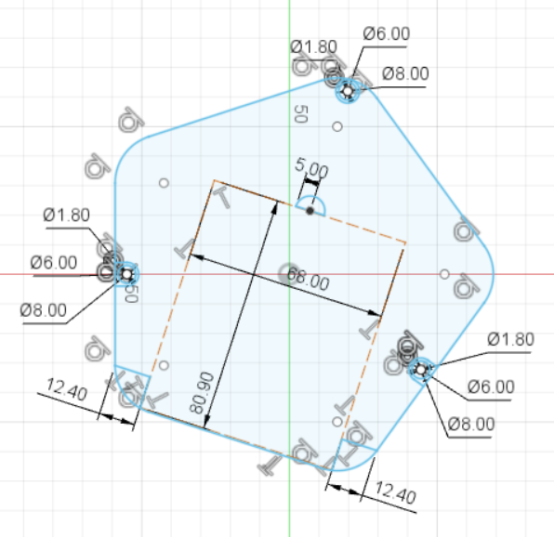
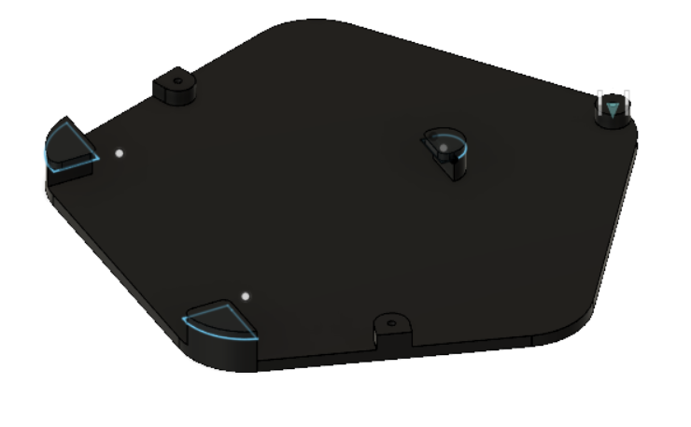
Creating sketch of the base
Extruding the base with its extensions

Slide 75
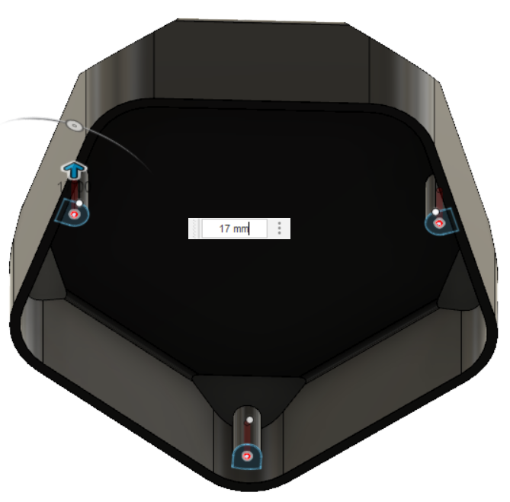
Projecting and extruding bosses and screw holes into the case

Slide 76
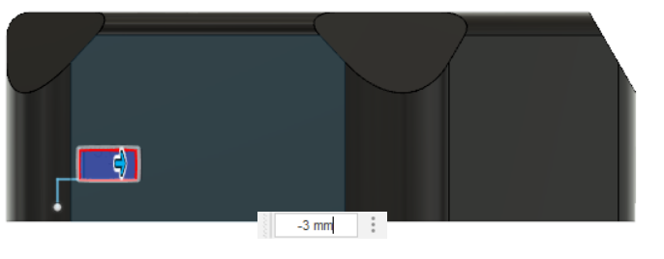
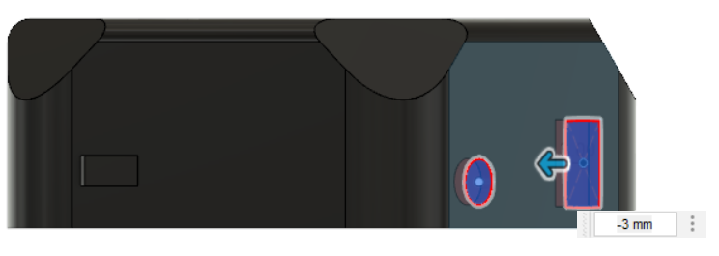
Extruding the micro-USB opening into the case
Extruding the electrodes and switch openings into the case

Slide 77
Results

Slide 78
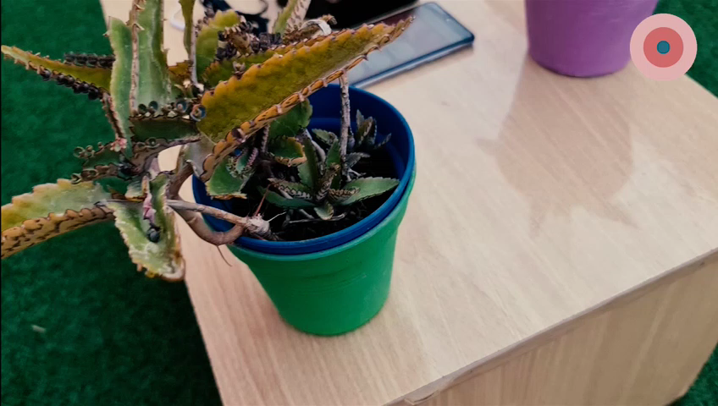

Slide 79
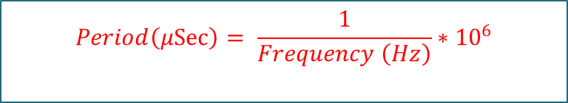
$$Period\left(μSec\right)= \frac{1}{Frequency \left(Hz\right)}∗{10}^{6}$$
$$Duty cycle (\%)=(Pulse width (μSec))/(Period (μSec) )×100$$
$$Duty value in code (0-1023)= Actual Duty cycle (\%)×1023$$
No. | Program | Frequency 'Fr' (Hz) |  | Pulse Width 'PW' (µSec) |  | Period "T" (µSec) |  | Duty (%) |  | Duty in code (0-1023)
 |  | Min | Max | Min | Max | Min | Max | Min | Max | Min | Max
1 | Wrist | 50 | 100 | 50 | 60 | 20000 | 10000 | 0.25 | 0.6 | 3.00 | 6.00
2 | Elbow | 1 | 5 | 50 | 300 | 1 000000 | 200000 | 0.005 | 0.15 | 1.00 | 5.00
3 | Shoulder | 4 | 10 | 150 | 250 | 250000 | 100000 | 0.06 | 0.25 | 1.00 | 5.00
4 | Quadriceps | 2 | 150 | 50 | 250 | 500000 | 6667 | 0.01 | 3.75 | 1.00 | 40.00
5 | Mid/Upper back | 2 | 120 | 100 | 250 | 500000 | 8333 | 0.02 | 3 | 1.00 | 35.00
6 | Low Back | 2 | 100 | 75 | 250 | 500000 | 10000 | 0.015 | 2.5 | 1.00 | 30.00
7 | Abdominal cramping | 2 | 30 | 80 | 120 | 500000 | 33333 | 0.016 | 0.36 | 1.00 | 5.00
8 | Hip | 2 | 80 | 100 | 150 | 500000 | 12500 | 0.02 | 1.2 | 1.00 | 15.00
9 | Knee | 5 | 150 | 50 | 150 | 200000 | 6667 | 0.025 | 2.25 | 1.00 | 25.00
10 | Ankle | 5 | 150 | 50 | 200 | 200000 | 6667 | 0.025 | 3 | 1.00 | 30.00
11 | Hand / Foot | 2 | 150 | 150 | 220 | 500000 | 6667 | 0.03 | 3.3 | 1.00 | 35.00

Slide 80
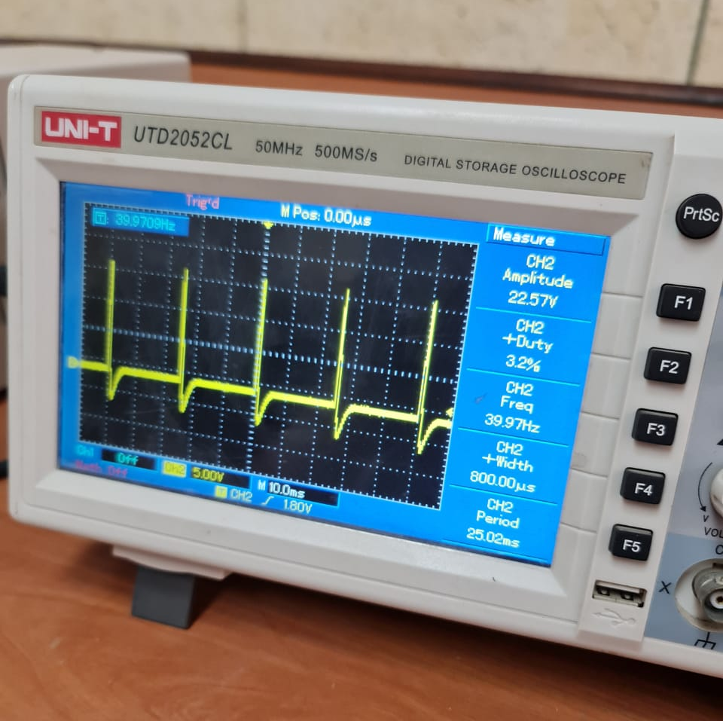
In this example we set in code the 40 Hz frequency value and 30 Duty cycle whish is equal a 3% as an actual duty cycle.

Slide 81

Measure the value of battery volt.

Slide 82


Slide 83


Slide 84

Side effect:
Tens units is safe for most people and will not usually experience any side effects.
the electrical impulses that a TENS unit produces may cause a buzzing, tingling, prickling sensation. or people may be allergic to the adhesive pads.

Slide 85
Future Work

Slide 86

Future Work:
Smaller
(Using nanotechnology)
More Efficiently
Less session Time
Built in with Electrodes

Slide 87

Future Design:

Slide 88

Future Design:

Slide 89
Thanks
All copyrights reserved for My Relief Team.

